Slide 1
Performance Measures
Planning and Implementation
Office of Justice Programs

Slide 2
Learning Objectives
Performance Management vs. Performance Measurement
How to plan for performance measurement
How to successfully implement performance measurement
Notes:
At the end of this presentation, you should walk away with a better understanding of the difference between performance management and performance measurement and how to plan for and successfully implement performance measurement.

Slide 3
Performance Management vs. Performance Measurement
Notes:
What do you think when you hear performance management?

Slide 4
Officially…
Performance management is the systematic use of strategic planning, goals, performance indicators, evaluation, analysis, and data driven reviews, evaluations, and reporting to improve the results of programs and the effectiveness and efficiency of agency operations.

Slide 5
But Really…
Performance management is primarily concerned with:
How the program is implemented
What the program is producing
Notes:
Implemented – hiring staff, buying equipment, attending training, creating policies
Producing – clients served, services provided, long term improvements
Program impact (outcomes) are usually measured in concert with performance through evaluations by a research partner or outside researcher.

Slide 6
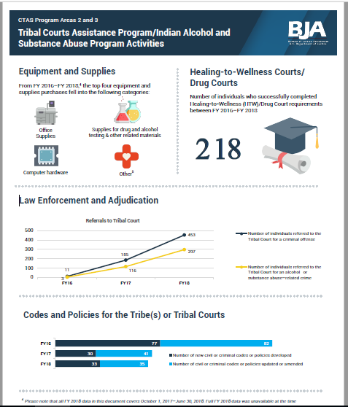
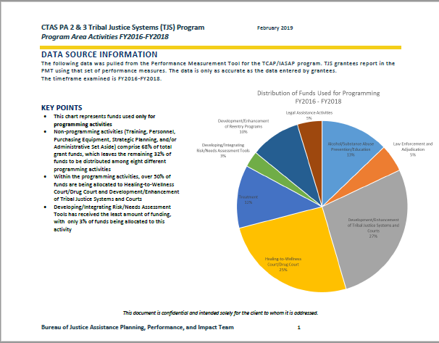
A Few Examples
Notes:
With the data you submit, we are able to produce progress update reports, snapshot and highlight reports, as well as run various analyses on allocations of funds and overall program success.

Slide 7
Officially…
Performance measurement is the ongoing collection and analysis of data and indicators that produce or reflect results in terms of measurable outcomes and outputs to determine a program’s progress toward its stated goals.

Slide 8
But Really…
Performance measurement is primarily concerned with:
How much progress has been made
What areas need improvement

Slide 9
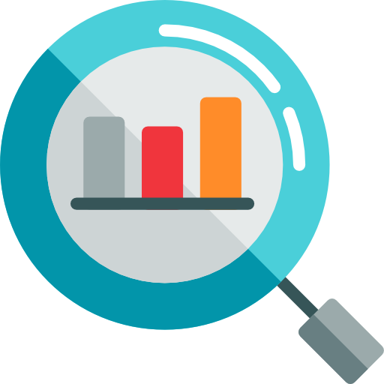
What are Performance Measures?
Inputs
Activities
Outputs
Outcomes
Program resources
Actions that convert inputs to outputs
Products or services
Measurable progress toward program goals
Description
Grant funding
Award administration
Identifying key personnel with access to crime and alcohol/ substance abuse data
Establishing information-sharing agreements
Targeted substance abuse prevention programs/initiatives
Provided risk/needs assessment
Diversion to Healing-to-Wellness Courts & Drug Courts
Reduced number of substance use disorder program participants that tested positive after 90 days
Increased number of specialty trained law enforcement officers
Example
Notes:
This graphic introduces the variety of types of performances measures we use to track progress toward program goals and identify areas for improvement.
- Inputs refer to program resources. Examples include grant funding, like where we ask about your program’s funding allocations by program activities, and personnel, which we get at through a variety of questions about cross-sector partners and community participation.
- Activities are the actions that convert inputs to outputs that eventually result in measureable progress toward the program’s goal. These can include things like trainings, meetings, partnership development, data analysis, and strategic planning.
- Outputs are the countable products or services that result from these actions.
- Outcomes speak to longer term program goals. Associated outcomes can be found in the outcome section at the end of the Performance Measure questionnaire.

Slide 10
Lifecycle of Performance Management
Data
Metrics
Understanding
Feedback
Program
Improves
Performance Measurement
Notes:
Grantees must provide data on their program activities.
The data collection system and program analysts calculate key performance metrics.
Grant managers and grantees review to understand what is going on with their program.
Grant manager and grantee work on actionable feedback.
This process repeats when you provide new data, leading to overall improvement in the program.
***
Performance measurement is the data piece – management is what you do with the data.

Slide 11
Performance Management Applications
Grant Managers
Grantees
To identify areas of success and potential areas of improvement.
To track grant activity and progress towards program goals.
To understand how funds are being distributed.
To comply with the GPRMA.
Identify areas for improvements to focus internal efforts.
Proactively request TTA to address challenges.
Generate evidence of progress toward program goals to enhance resource advocacy for sustainability.
Notes:
Performance management benefits both the federal grant managers and the grantees. They are developed with input from a variety of stakeholders, including grantees, and are directly related to the requirements of your grant award.
This information is used to:
identify areas of success and potential opportunities for improvement;
track grant progress toward program goals;
understand how funds are distributed; and
to comply with the Government Performance and Results Modernization Act of 2010
Grantees can use performance measures to accomplish many of the same goals, like identifying areas for improvement to focus internal efforts, proactively request assistance to address challenges, and develop evidence of program progress that can be used to enhance advocacy and sustainability.

Slide 12
Planning for Performance Measurement
Designate a performance measurement POC to oversee data collection and reporting.
Understand reporting requirements.
Review the solicitation
Know what system to report in (PMT, GMS, other)
Look at the reporting schedule
Develop a plan.
Who is responsible? When do tasks need to be done? How will the data be managed?
Notes:
While not required, it is beneficial to establish a performance measurement point of contact to oversee data collection and reporting. This vests someone with the authority and responsibility for performance reporting. They will also have access to the PMT (if applicable)
Your plan should include:
1 – identifying the person responsible for collection, aggregation, entry, and verification of data
2 – knowing when internal system should be updated, when aggregation begins, when entered, when checked
3 – assuring awareness of security, restrictions, confidentiality, storage, backup protocols
4 – training example

Slide 13
Implementing Performance Measurement
Collect data with a case/records management system, spreadsheet, or intake/client/service form.
Training should be provided
Aggregate the data each reporting period and verify accuracy.
Report your data.
How and when depends on your program
Notes:
Data collection is the first step in implementing performance measurement. Everyone should receive training on data collection so there is a consensus on what to record and how to record it.
Each reporting period, someone will need to aggregate all the data in preparation for reporting. Data should also be verified and prorated, if needed.
How and when you report your data will depend on your program. Failure to report will result in GMS automatically freezing your funds. All systems send out notifications to remind POCs about reporting.

Slide 14
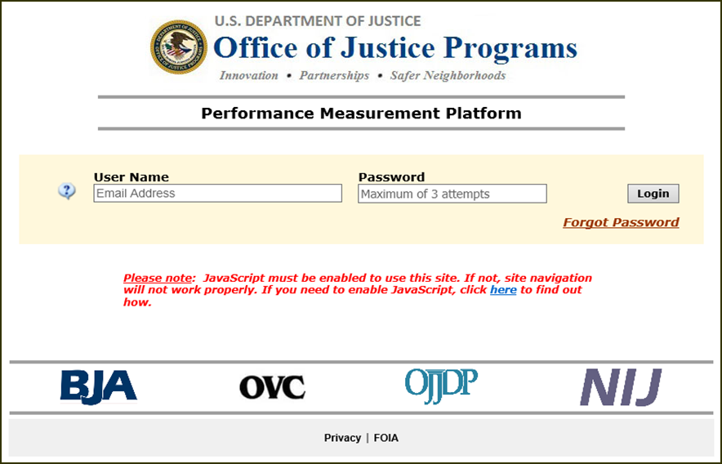
What is the PMT?
OJP’s PMT is the online system required for grantee performance measurement reporting.
Used by many OVC, BJA, NIJ, and OJJDP grantees
Please access the PMT at: https://ojpsso.ojp.gov
Log-In Instructions and Help Desk Information: https://ojpsso.ojp.gov/support/OJP_PMP_SSO_Login_Instructions.pdf
Notes:
Some of you will be responsible for imputing your data into the PMT system
So, what exactly is the PMT?
The Performance Measurement Tool is the online data collection tool for Office of Justice Program’s grant recipients. It is structured as an online questionnaire, and is available year round.
Indicators, statistics, and metrics obtained from the PMT are used to assess program performance and gauge progress toward program goals. They may also be used to improve program and policy decisions at the federal level.
The PMT contains a lot of information and numerous tools to assist you in your reporting and Helpdesk Analysts are available to assist with your reporting requirements.

Slide 15
Grants Management System
Regardless of how you provide your data, you are required to upload a copy of your progress report to GMS semi-annually.

Slide 16
Quick Reference Reporting Schedule I
Reporting Period | Data Required | PMT Due Date | Upload to GMS?
October 1–December 31 | Performance Measures and Narrative Questions | January 30 | Yes January 30
January 1–March 31 | Performance Measures | April 30 | No
April 1–June 30 | Performance Measures and Narrative Questions | July 30 | Yes July 30
July 1–September 30 | Performance Measures | October 30 | No
Last Reporting Period of Award | Performance Measures, Narrative Questions, and Closeout Questions | 30 Days After End of Reporting Period | Yes 30 Days After End of Reporting Period
Reports Due:
January 30 · April 30
July 30 · October 30
Notes:
This table outlines the type of data you’ll be reporting each reporting period, when your reports are due in the PMT, and whether you also need to upload your reports to GMS. As you can see from the alternating values under the second column, you’ll only report on the narrative questions in January, July, and during your last reporting period of grant activity, regardless of where that falls on the schedule.
As you can see, the PMT is only open for data entry during the month after a reporting period closes. The PMT is accessible year-round for you to review and edit your data, generate reports, and more, but you will need to contact the PMT Helpdesk to help you unlock reports as needed.

Slide 17
Quick Reference Reporting Schedule II
Reporting Period | Data Required | PMT Due Date | Upload to GMS?
January 1—June 30 | Performance Measures and Narrative Questions | July 30 | Yes July 30
July 1–December 30 | Performance Measures And Narrative Questions | Januarry 30 | Yes January 30
Title II Formula October—September | Performance Measures and Narrative Questions | December 30 | Yes December 30
Last Reporting Period of Award | Performance Measures, Narrative Questions, and Closeout Questions | 30 Days After End of Reporting Period | Yes 30 Days After End of Reporting Period
Reports Due:
July 30 · January 30
December 30

Slide 18
Enhancing Data Quality
Quarterly Data Verifications
Who? → Research Analysts and Helpdesk Support Specialists
What? → Assessment of data consistency and accuracy; Outreach encouraging grantees to review and revise entries
Site Visits
Who? → Grant Managers
What? → Assess data accuracy by identifying documentation to support data entries for major activities
Notes:
Let’s quickly review the importance of ensuring data accuracy through quality assurance. Research analysts assess data consistency and accuracy and reach out to grantees with potential issues. Program grant managers also play a role in enhancing performance data quality through site visits, where they identify documentation to verify data entries for major activities.

Slide 19
What We Do With the Data
Respond to Data Requests: team of Research Analysts can promptly respond to data requests from the press, public, or federal auditors (e.g., GAO, OIG, etc.)
Share Success: use a variety of reports to highlight program success with external audiences, including Congress
Notes:
Which is why it is imperative that data is reported accurately and consistently.

Slide 20
Resources
Performance Measurement Platform: https://ojpsso.ojp.gov/
Log-In Instructions:
https://ojpsso.ojp.gov/support/OJP_PMP_SSO_Login_Instructions.pdf
BJA: https://bja.gov/
OJJDP: https://www.ojjdp.gov/
OVC: https://www.ovc.gov/
NIJ: https://www.nij.gov/

Slide 21
Contact Information
Grants Management System
Performance Measurement Tool
GMSHelpdesk@usdoj.gov
1-888-549-9901
BJA: bjapmt@usdoj.gov (1-888-252-6867)
OVC: ovcpmt@usdoj.gov (1-844-884-2503)
NIJ: nijpmt@usdoj.gov (1-844-884-2504)
OJJDP: ojjdppmt@usdoj.gov (1-866-487-0512)

